Slide 1
Y-Prize A Social Innovation Project
WeSoL
Creating a BRIGHTER future!!!
Notes:
Briefly describe the business and highlight its purpose. How will it be achieved?

Slide 2
Who We are: Alex Wang Jin Tai Jonathan Wilson Sydni Dunn Timothy Snow Tyler Young Tyson James
Notes:
Who we are and why we are the right ones for the job?

Slide 3
Our Product/Idea
Produce and sell 3D solar lamps using recycled material
Innovative and gives us complete control over production and product
Provides jobs and education in Uganda
Assumption that making the product will be cheaper than what is already on the market
Assumption that people like 3D
Surveyed over 100 people on BYU campus and they like the idea of 3D printed products
They need the right price and durability to be adequate
We need to explain why our light works for our solution
Notes:
Briefly describe what you are selling? what are the benefits? Describe its features? (warranty, ease of use, comfort, safety, taste, flexibility)

Slide 4
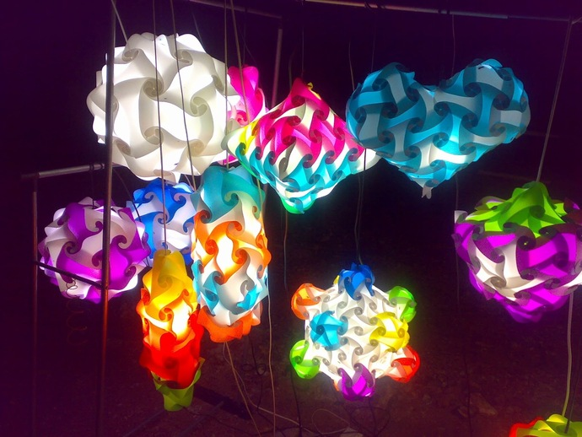
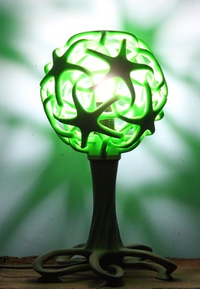
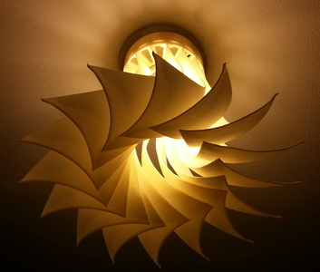
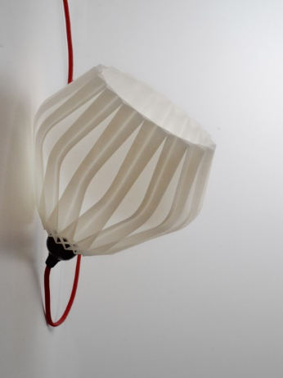

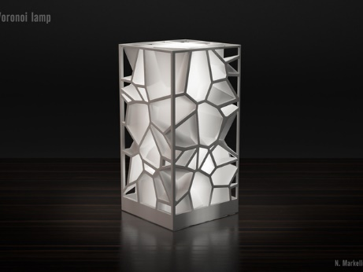
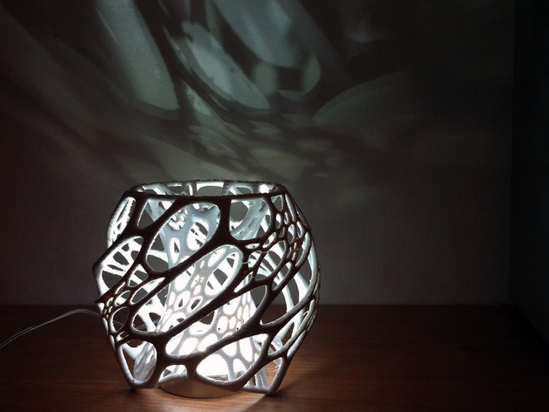
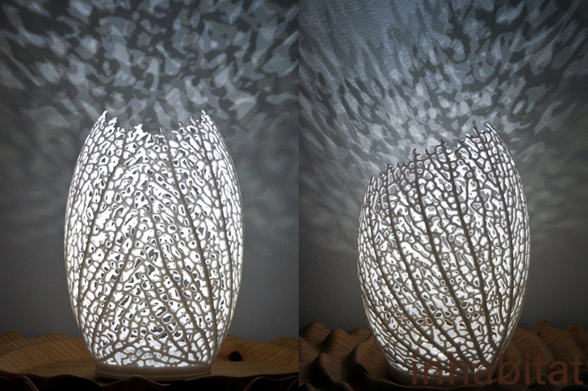

Slide 5
Market
25% of Uganda population in under the poverty line.
However around 68% of the people are without electricity.
The International Energy Agency estimates that 30 million people in Uganda live off the electrical grid.
Kampala has a power grid but it doesn’t reach everyone in the city and there are brown/black outs.
$5 per month spent on light options (Kerosene and Candles)
Notes:
Briefly describe what you are selling? what are the benefits? Describe its features? (warranty, ease of use, comfort, safety, taste, flexibility)

Slide 6
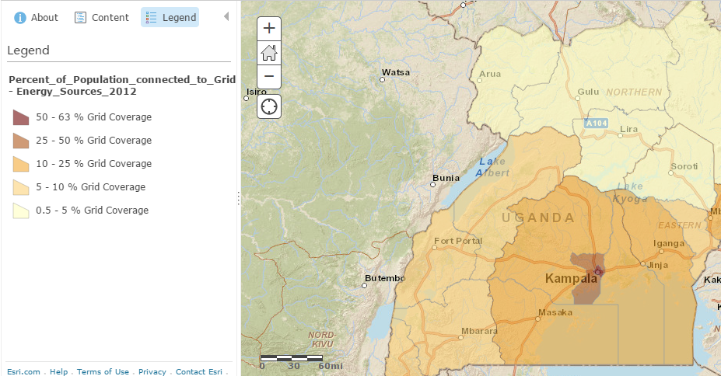

Slide 7
Place
Kampala, the capital
Kampala population is 1.5-2 million
Average monthly income in 2010 US$480, GDP has increased so we assume that monthly income has increased as well.
Has a wide range of backgrounds. It relies heavily on the lake for electricity. So when lake doesn’t run, the electricity stops. Most wealthy people have generators.
Notes:
Briefly describe what you are selling? what are the benefits? Describe its features? (warranty, ease of use, comfort, safety, taste, flexibility)

Slide 8
Price
Our Costs
Cost to print the housing $2.75
Cost for components $7.50
Tunapanda contract for manufacturing $X.xx
Overhead $X.xx
Sales Team $X.xx
Price for Customer
We will charge $X.xx
XX% will pay at time of purchase, XX% will need financing
Notes:
Briefly describe what you are selling? what are the benefits? Describe its features? (warranty, ease of use, comfort, safety, taste, flexibility)

Slide 9
Printing Problem
We have found that it takes 15 total hours to print our housing (on our printer)
That is 4500 hours or 180 days to print 300 housings.
We need to find out their time
They have 3 printers, we could split our printing
We need to find better design or printing solution
Notes:
Briefly describe what you are selling? what are the benefits? Describe its features? (warranty, ease of use, comfort, safety, taste, flexibility)

Slide 10
Promotion
Timeline:
Initial Summer
Get to Uganda and establish a base.
Go to locations in Kampala and display the power of 3D printing along with our prototype
Sell in the summer exhibits and at locations where other means of lighting are already sold
Next Phase
Hire sales team to go out to villages
Build assembly locations in centralized villages
Sales personnel travel on motorbikes to reach small villages
Notes:
Briefly describe what you are selling? what are the benefits? Describe its features? (warranty, ease of use, comfort, safety, taste, flexibility)

Slide 11
1st Summer - Trial
Sales focus is on Kampala
Rent location close to manufacturing facility
Marketing
Take our 3D printer out to large gatherings and demonstrate the tech, sell lights at the same time (June 9th Heros day, sometime in Aug)
Use small teardown shops to sell lights at night
Sell in the large summer expos
This will be handled by our core team (2-3 people in country)

Slide 12





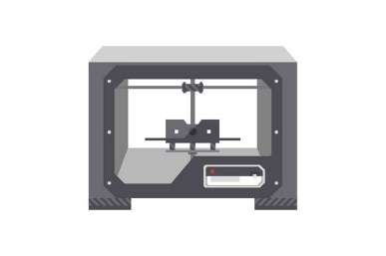
Operations in Kampala
Assembly
Sales
Customers

Slide 13
2nd Phase - Expansion
Develop additional manufacturing or storage facilities across country
Locate key warehouse/manufacturing cities (Mbarra, Fort Portal, Mbale, Lira, Gulu)
Need to determine the cost for warehouse vs. manufacturing (3D printing and assembly)
Make a diagram for this
Include pricing model

Slide 14
Operations in Cities
Warehouse 1
Sales
Customers
Warehouse 2
Sales
Customers

Slide 15
3rd Phase - To The Last Mile
Hire a sales team to go to individual villages
Delivery on motorbike
Several villages in a day

Slide 16

Operations in Villages
Village 1
Village 2
Village 3
Warehouse 1

Slide 17

Management and Organization Tunapanda
Notes:
Describe the people involved. Highlight strenthgs and how to overcome weaknesses

Slide 18
Replacements
We will provide a warranty
Only need to replace individual components and not entire system
Allow for quicker replacement of inventory and reduce costs
Notes:
Briefly describe what you are selling? what are the benefits? Describe its features? (warranty, ease of use, comfort, safety, taste, flexibility)

Slide 19
Financial Aspect
Profit vs loss
cash flow/balance flow - working through the details currently with Tunapanda.
Notes:
Briefly describe what you are selling? what are the benefits? Describe its features? (warranty, ease of use, comfort, safety, taste, flexibility)

Slide 20
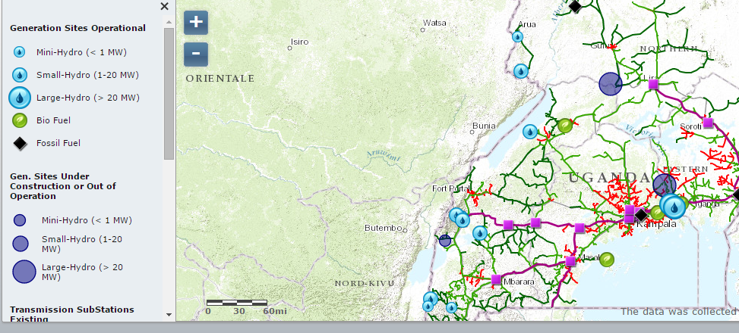

Slide 21
